Slide 1
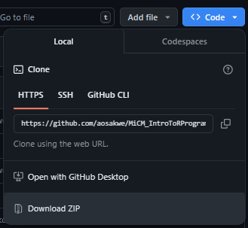
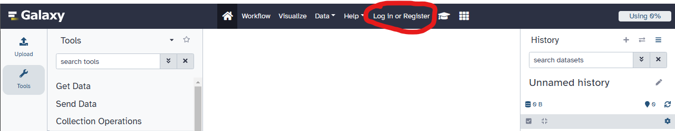
1. Go to https://github.com/aosakwe/MiCM_IntroToRNA and download the workshop materials ZIP (under the blue code button)
2. Go to https://usegalaxy.org/ and create an account (don’t forget to verify it!)

Slide 2
Introduction to RNA-seq
Workshop Lead: Adrien Osakwe
Facilitator: Jeffrey Yu
Date: June 27, 2024

Slide 3



Mission statement: deliver quality workshops designed to help biomedical researchers develop the skills they need to succeed.
Location: 550 Sherbrooke Street, Montreal, Quebec
Scan the QR code to sign up
for our mailing list
Contact: workshop-micm@mcgill.ca

Slide 4
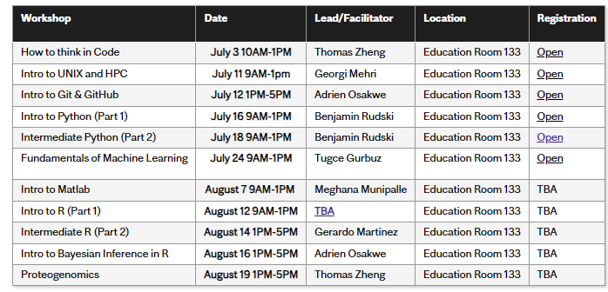
Summer 2024 Workshop Series
https://www.mcgill.ca/micm/training/workshops-series

Slide 5
Outline
Introduction (~10 mins)
Experimental Design (~20 mins)
Processing & Quality Control (~30 mins)
Analysis (~1h30 mins)
Single Cell Data (~45 mins)

Slide 6
Acknowledgements
Material
Reinnier Padilla (HGEN)
Exercises
Galaxy Tutorial Page
DESeq2 Vignettes
OSCA eBook
Data
10X Genomics
Stephen Turner

Slide 7
Introduction

Slide 8
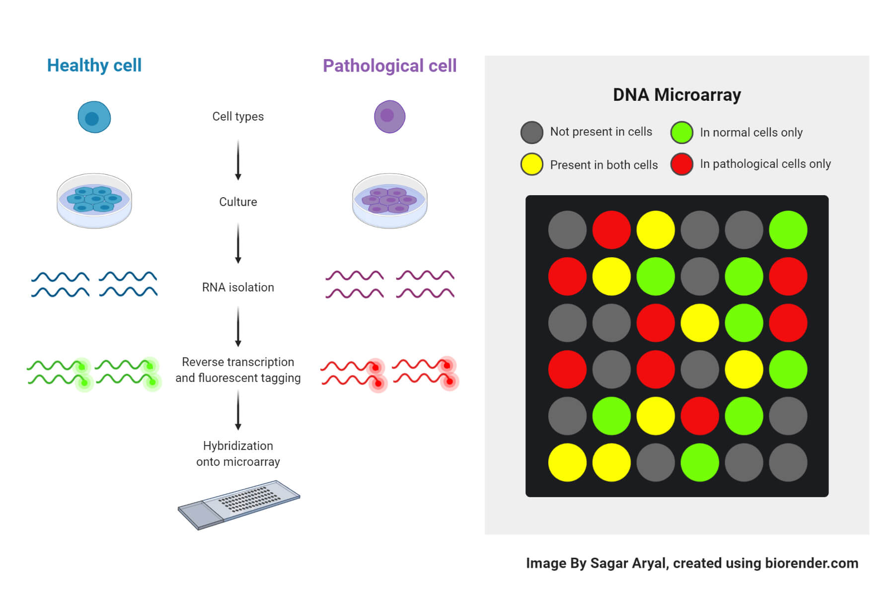
Limitations of Microarrays
Microarrays are insufficient for large-scale research
Can only study known mRNA transcripts
Does not generate counts

Slide 9
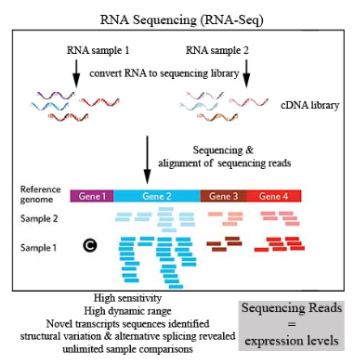
RNA Sequencing
RNA-seq provides a high-throughput way to explore gene expression
Can discover novel transcripts & isoforms
Can perform more complicated analyses
Incorporate covariates (sex, age, etc.)
Image Source: otogenetics

Slide 10
Experimental Design

Slide 11
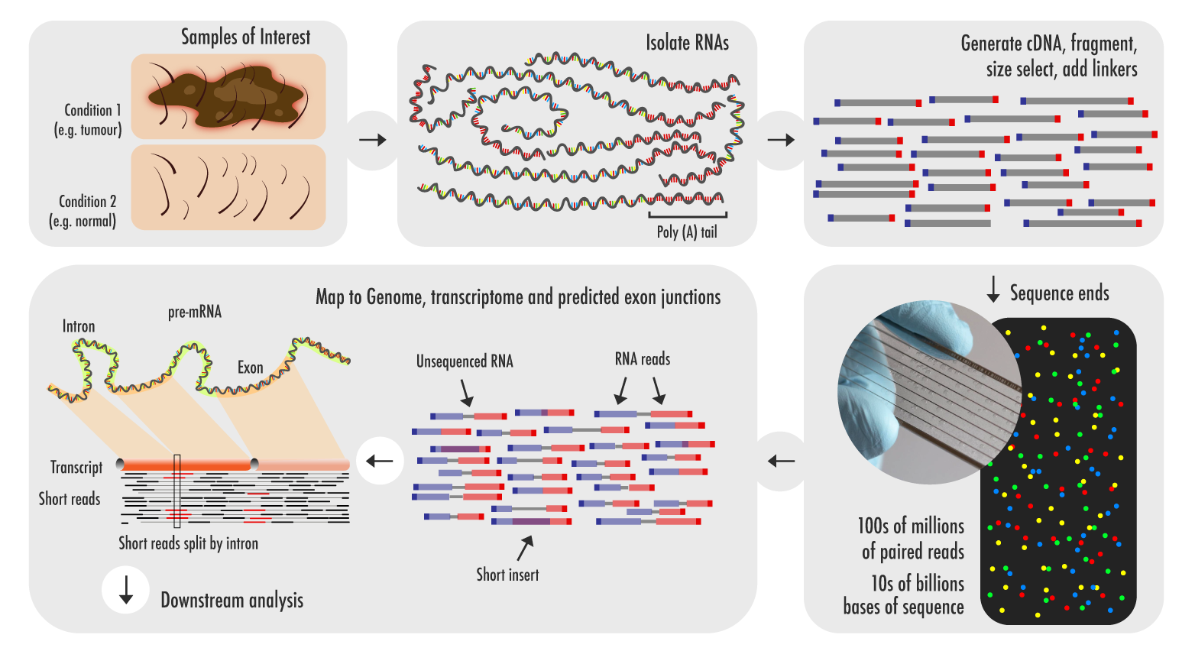
RNA-seq Protocol
Image Source: Technology Networks – Genomics Research

Slide 12
Extraction Protocols
Majority of RNA in sample may not be relevant
Ribosomal RNA (rRNA – 90% of all transcripts)
Extraction protocols aim to enrich sample for mRNA
Poly(A) Selection
Requires a lot of mRNA and minimal degradation (RIN)
rRNA Depletion

Slide 13
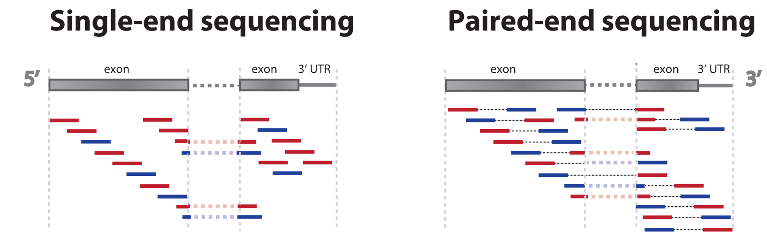
Single-end vs. Paired-end Reads
Image Source: statomics.github.io

Slide 14
Single-end vs Paired-end Reads
Single-end Reads
Cheaper
Faster
Sufficient for well-annotated genomes
Paired-end Reads
Higher accuracy
Better alignment
Better for de-novo assembly

Slide 15
Read Length
How many base pairs are read at a time
50, 100 or more base pairs
Longer reads are better for alignment and assembly
Are also more expensive
50bp may be sufficient for differential expression
100bp> is more reliable for isoform studies

Slide 16
Library Size
# of sequenced reads per sample
Large libraries are better at finding rare transcripts
BUT large libraries are at risk of noise and contamination
Consider using saturation curves
Notes:
HVG –5 million is enough
Not hvg or low expression – up to 100 million
Single cell – 1 million reads
50000 reads enough for most HVGs

Slide 17
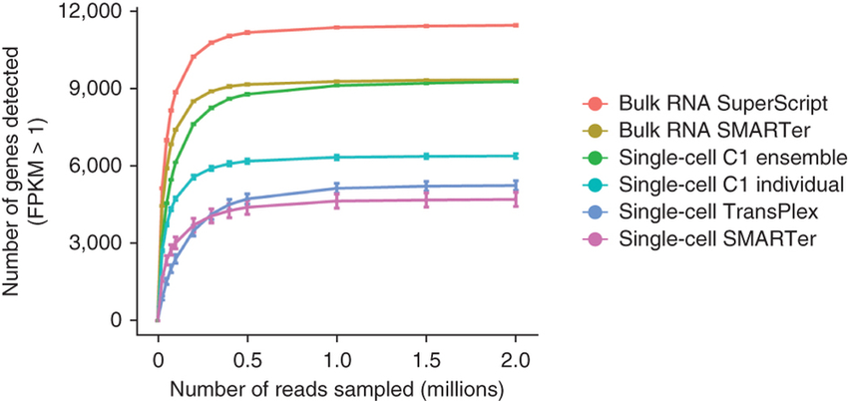
Library Size // Sequencing Depth
Image Source: Angela R Wu

Slide 18
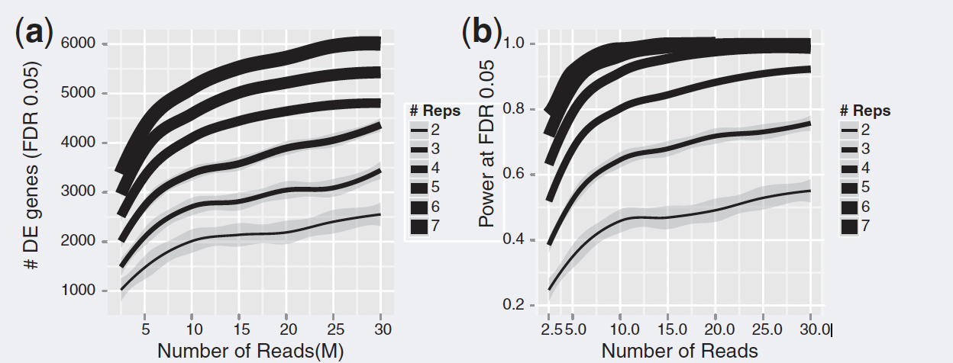
Number of Replicates
Liu, Y., Zhou, J. & White, K. P. Bioinformatics 30, 301-304, doi:10.1093/bioinformatics/btt688 (2014).

Slide 19
Other Considerations
Need to consider technical and biological variability
What is our desired statistical power?
Plan sequencing experiments
randomized sample processing
ensuring covariates are well mixed across batches
Three replicates seen as bare minimum for inference
Recommend running a power analysis
Scotty tool helps determine optimal # of replicates and library size

Slide 20
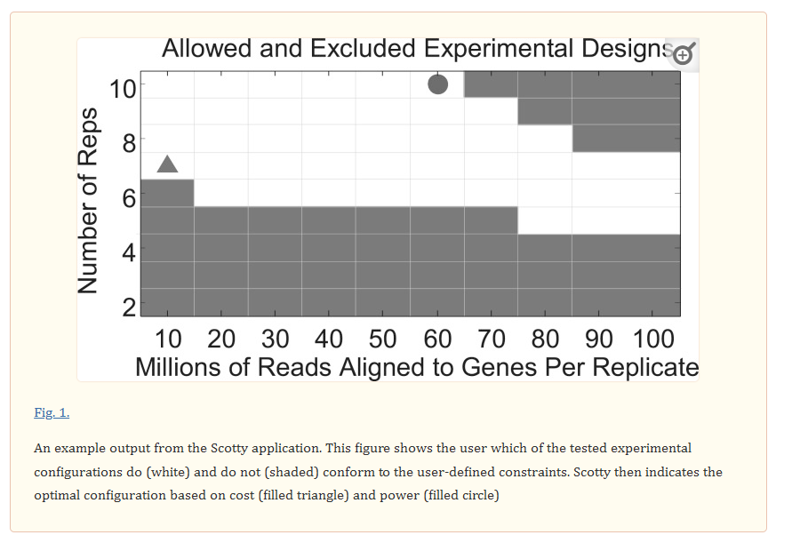
Scotty Tool
http://scotty.genetics.utah.edu/

Slide 21
Processing & Quality Control (Galaxy)

Slide 22
Exercise: Galaxy Tool

Slide 23
RNA-seq Processing Protocol
RNA extraction/processing
STAR
Samtools
FeatureCounts
DESeq2
BAM
Alignment to genome
BAI
Indexing of BAM file
FASTQ
Raw sequence
Raw counts
Quantification
dds
Differential Gene Expression

Slide 24
Read Quality
Quality control of raw reads involves the following metrics/indicators:
sequence quality
GC content
k-mer overrepresentation
duplicated reads (sequencing errors)
Adapter presence
PCR artifacts
sample/RNA contamination
Satisfactory Duplication, k-mer and GC content levels will vary
expect samples to have similar estimates within an experiment.
Discard samples over 30% disagreement.
FASTQC for Illumina-based reads or NGSQC for any platform.
Sequence quality decreases towards 3’ end of the sequence
can trim 3’ end to increase mappability (Trimmomatic)
Notes:
Satisfactory duplication, k-mer and GC content levels will vary between experiments and organisms.
However, we expect samples to have similar estimates for each within an experiment.
A rule-of-thumb is to discard samples over 30% disagreement.
These analyses can be done by FASTQC for Illumina-based reads or NGSQC for any platform.
In general, sequence quality decreases as we approach the 3’ end of the sequence. If the quality drops too much, we can trim the 3’ of reads to increase mappability. This can be done by method such as FASTX-Toolkit and Trimmomatic.

Slide 25
Exercise: FASTQC

Slide 26
Alignment
Two Approaches
Reference-based Alignment
Using either a reference genome or transcriptome
De-novo Assembly
Creates a new reference based on your sequenced reads

Slide 27
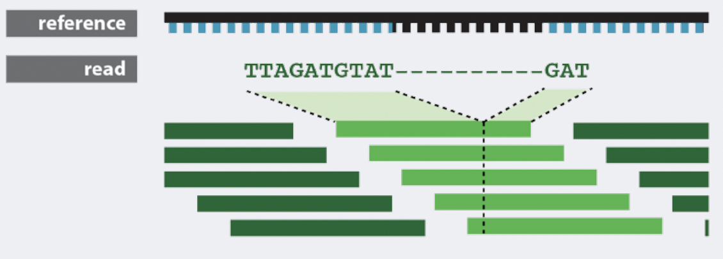
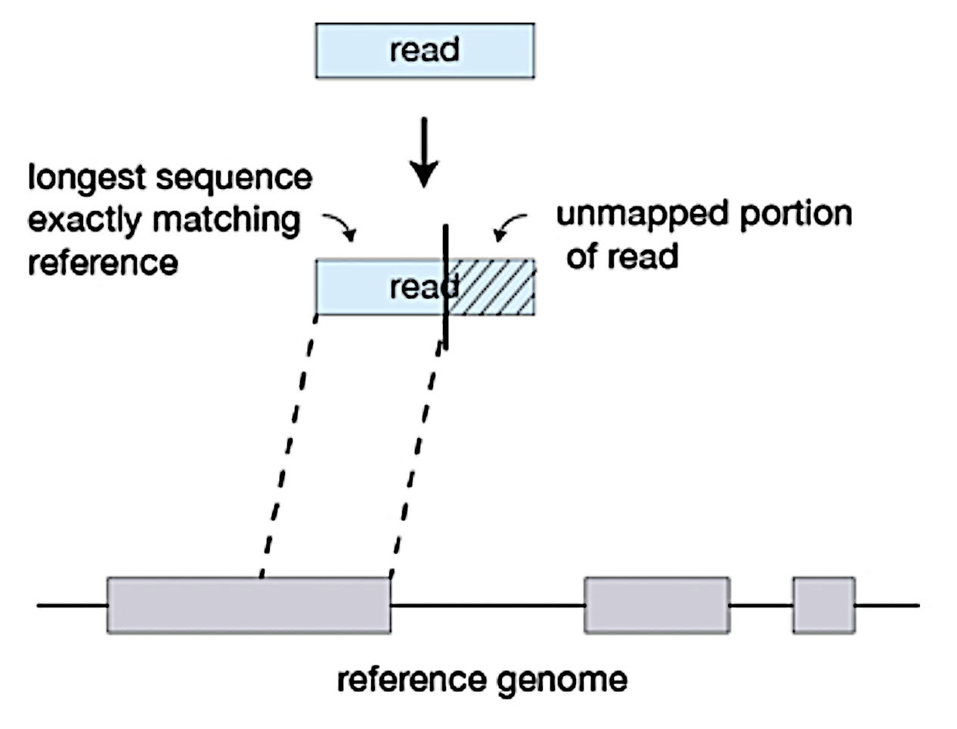
STAR Alignment
exon
intron
exon
Maximal mappable prefixes (MMPs)
Notes:
RNA-seq reads are derived from mature mRNA. But aligners use a reference genome to aid in the process, so a read spans two exons while the reference would have one exon followed by an intron.
Hence, the reference genome would find a matching sequence in only one of the exons, while the rest of the read would not match the intron in the reference, so the read can't be properly aligned.
A splice-aware aligner would know not to try to align RNA-seq reads to introns, and would identify possible downstream exons and try to align to those instead, ignoring introns altogether.
A DNA-DNA aligner (i.e., splice-unaware) would have to introduce a long gap in the mapping of a read to span an intron. This might lead to false mappings.
‘Spliced Transcripts Alignment to a Reference (STAR)’
STAR is an aligner designed to specifically address many of the challenges of RNA-seq data mapping to account for spliced alignments.
STAR is shown to have high accuracy, but it is memory intensive. The algorithm achieves this highly efficient mapping by performing a two-step process:
Seed searching
Clustering, stitching, and scoring
Seed searching
For every read that STAR aligns, STAR will search for the longest sequence that exactly matches one or more locations on the reference genome. These longest matching sequences are called the Maximal Mappable Prefixes (MMPs):

Slide 28
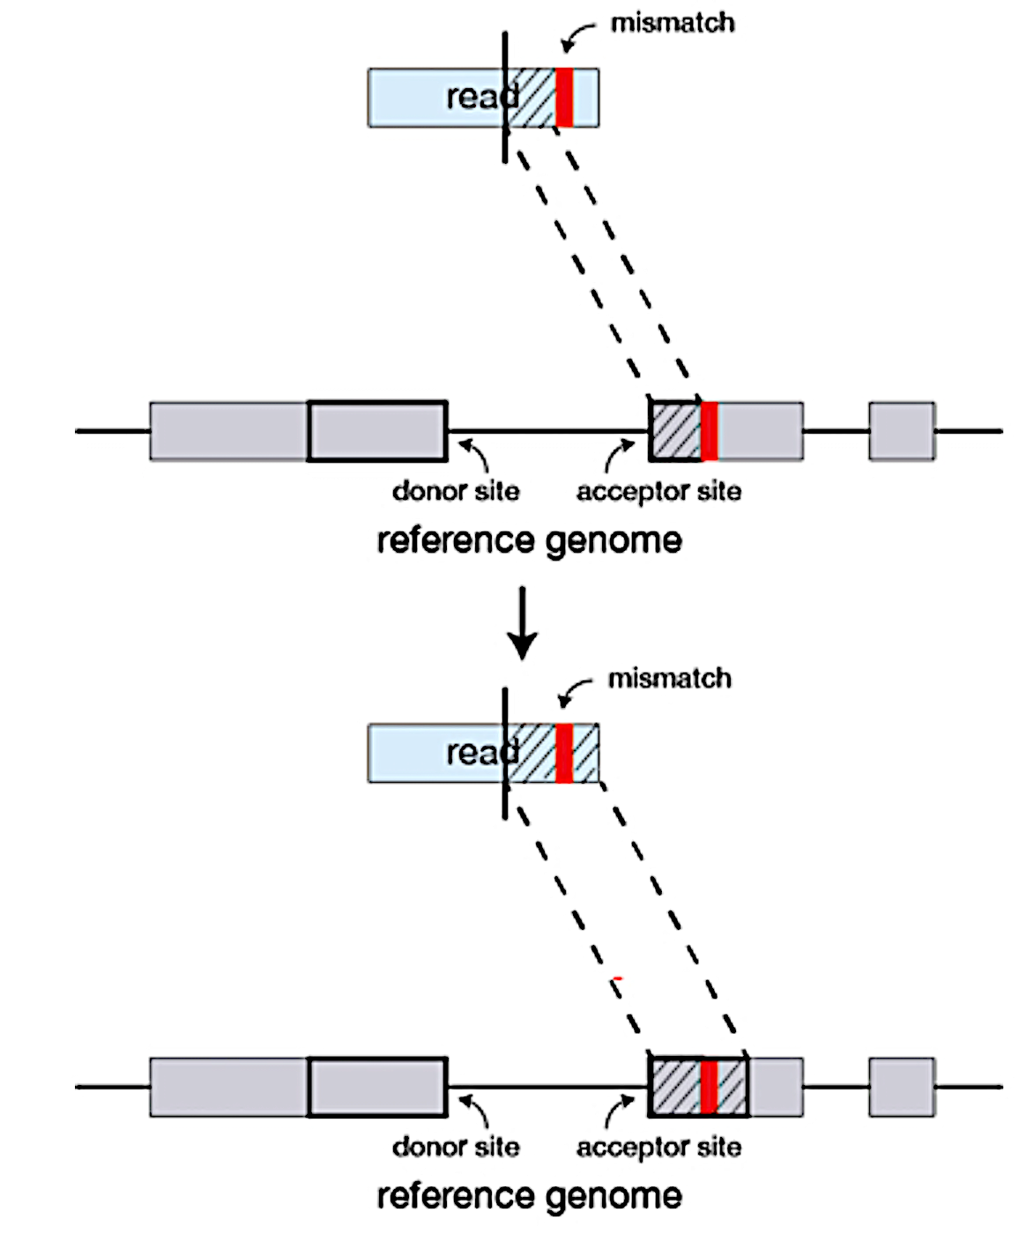
STAR Alignment
Notes:
Bowtie as an alternative for reference transcriptomes

Slide 29
Transcript Alignment
Can map reads to a genome or transcriptome
Crucial quality metric is the percentage of mapped reads.
estimate of sequencing accuracy and contamination.
expect 70-90% of reads to map to the human genome
significant proportion of reads mapping to small number of identical regions (multi-mapping reads).
Examine uniformity of read coverage on exons and the mapped strand.
GC content of mapped reads can also reveal PCR biases
Tools such as Picard, RSeQC and Qualimap can be used for alignment QC.
Notes:
Reads can be mapped to a genome or transcriptome depending on your research question and the quality of the reference panel.
A crucial quality metric is the percentage of mapped reads. This acts as an estimate of sequencing accuracy and of contamination. We expect 70-90% of reads to map to the human genome with a significant proportion of reads mapping to a small number of identical regions with similar quality (multi-mapping reads). When mapped to the transcriptome, we expect a slight decrease in percentage as reads from unannotated transcripts are lost and an increase in multi-mapping reads.
We also examine the uniformity of read coverage on exons and the mapped strand. Reads accumulating in the 3’ end of transcripts in a poly(A) selected sample may indicate low quality RNA. GC content of mapped reads can also reveal PCR biases (REVIEW). Tools such as Picard, RSeQC and Qualimap can be used for alignment.

Slide 30
Transcript Identification
With a reference genome, we can determine what transcripts RNA-seq reads represent.
Prevents the discovery of novel transcripts and emphasizes quantification.
Without a reference, need to assemble reads into contigs that represent candidate transcripts.
Read coverage can be used to determine expression level in both cases.
Notes:
In the presence of a reference genome, RNA-seq reads will be mapped onto the genome or transcriptome, to determine what transcript they represent. Using a reference transcriptome prevents the discovery of novel transcripts and emphasizes quantification.
In the absence of a sequenced genome, we first need to assemble reads into contigs which represent the candidate transcriptome which we can map the reads to for quantification. Read coverage can be used to determine expression level in both cases. Transcript identification and quantification and be done jointly or sequentially.
Alignment
As mentioned previously, we have the choice between mapping to a reference genome or transcriptome. Both approaches often find reads that map to multiple regions due to repetitive sequences or shared protein domains across genes. These account for a large proportion of reads (even larger when using a transcriptome due to isoforms) and SHOULD NOT be discarded. In isoform-based analyses, proper transcript identification and quantification will require more rigour to generate reproducible insights.

Slide 31
De novo alignment & Transcript Discovery
Short reads struggle to accurately infer full-length transcripts.
Tools like GRIT can help improve this with CAGE/RAMPAGE data
Paired-end reads are also helpful
An easier solution is to use long read sequencing data
PacBio, Oxford-Nanopore
De novo assembly can be done by tools such as Trinity, SOAPdenovo-Trans, Oases and Trans-AByS
Important to pool reads in comparative analysis during De novo assembly
Notes:
Transcript Discovery
As short reads rarely span across splice junctions, they struggle to accurately infer full-length transcripts. It is possible to use tools such as GRIT which incorporate CAGE or RAMPAGE data to improve annotation ability. In general, paired-end reads and sequencing depth and replicates can greatly reduce false positive for transcript discovery. Methods that were adapted to this task for short read data include Cufflinks, iReckon, SLIDE, StringTie and Montebello.
An easier solution if isoforms or novel transcript discovery is desired is to use long read sequencing data such as SMRT, which will identify more accurate contigs and map to reference transcriptomes with greater ease.
De novo transcript reconstruction
If there is no reference genome available, then RNA reads must be assembled de novo. There exists many packages for this task including SOAPdenovo-Trans, Oases, Trans-AByS and Trinity. Paired-end strand-specific sequencing or long read sequencing are usually preferred for this task. Too low (miss lowly expressed genes) and too high (contamination risk and increased runtime) of a sequencing depth can be problematic for accurate inference. It is therefore recommended to reduce the number of reads in silico for deeply sequenced samples. In comparative analyses, it is important to pool all reads together to generate a single set of contigs.

Slide 32
Transcript Quantification
This step generates the count matrix
the number of reads mapping to a given transcript sequence.
HTSeq-count or featureCounts aggregate raw counts.
gene-level quantification uses a gene transfer format (GTF) file containing genome coordinates of exons and genes
raw read counts are not ideal for analysis
Need normalized metrics for fair comparisons
Correction for transcript-length is crucial for within-sample comparison across genes
Although TPM facilitates cross-sample comparisons, it still has biases which could be resolved by other techniques
Notes:
Cufflinks however can identify cases where there are significant differences in gene length across samples that must be addressed.

Slide 33
Count Normalization
Reads per kilobase of exon model per million reads (RPKM)
RPKM is a within-sample normalization method which removes transcript-length and library size effects
Designed for single-end reads
Fragments per kilobase of exen model per million mapped reads (FPKM)
FPKM is an extension of RPKM designed for paired-end reads
Each pair of reads are treated as one fragment here (if they both were mapped). This avoids counting a fragment twice which cannot be done by RPKM.
Renders the same output as RPKM on single-end reads.
Transcripts per million (TPM)
TPM is an extension of RPKM where we first normalize by transcript length and then normalize by sequencing depth.
The some of all TPMs is the same for each sample, making it easier to compare the proportion of reads mapped to a gene across samples.
Can also convert FPKM counts into TPM

Slide 34
Quantification & Reproducibility
If the reference transcriptome is well annotated, we can use biotype composition to further assess sample quality.
Useful plots can be provided by NOISeq and EDA-seq in R.
We expect technical replicates to have a high reproducibility for gene expression (Spearman 𝑅2>0.9).
Reproducibility across biological replicates will vary.
Consider PCA plots (later)

Slide 35
Analysis (R)

Slide 36
Exercise: Bioconductor

Slide 37
Exploratory vs. Inferential Analysis
Exploratory
Hypothesis-generating
More freedom in analysis pipeline
Helps you design your analysis pipeline
Inferential Analysis
Hypothesis testing
Need to decide analysis pipeline beforehand
Risk of double-dipping

Slide 38
Filtering Genes
Remove by functional category
Mitochondrial RNA
Ribosomal RNA
Select for highly variable genes
Reduces computational cost
Potentially reduces noise
Risk losing novel genes

Slide 39
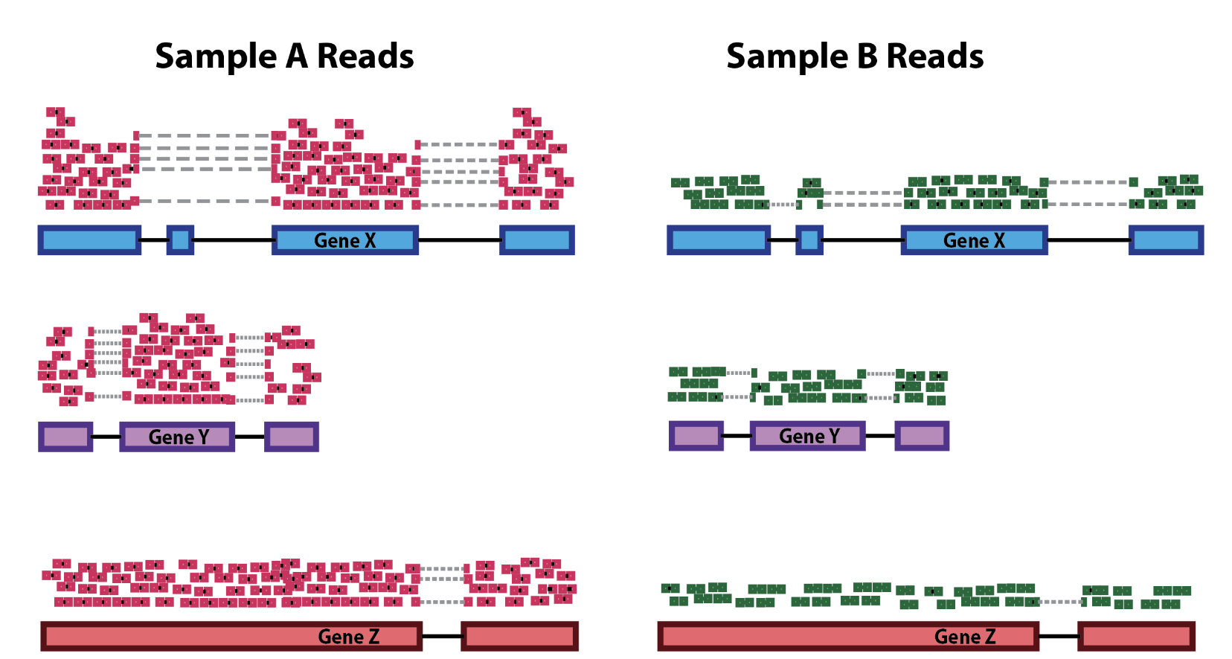
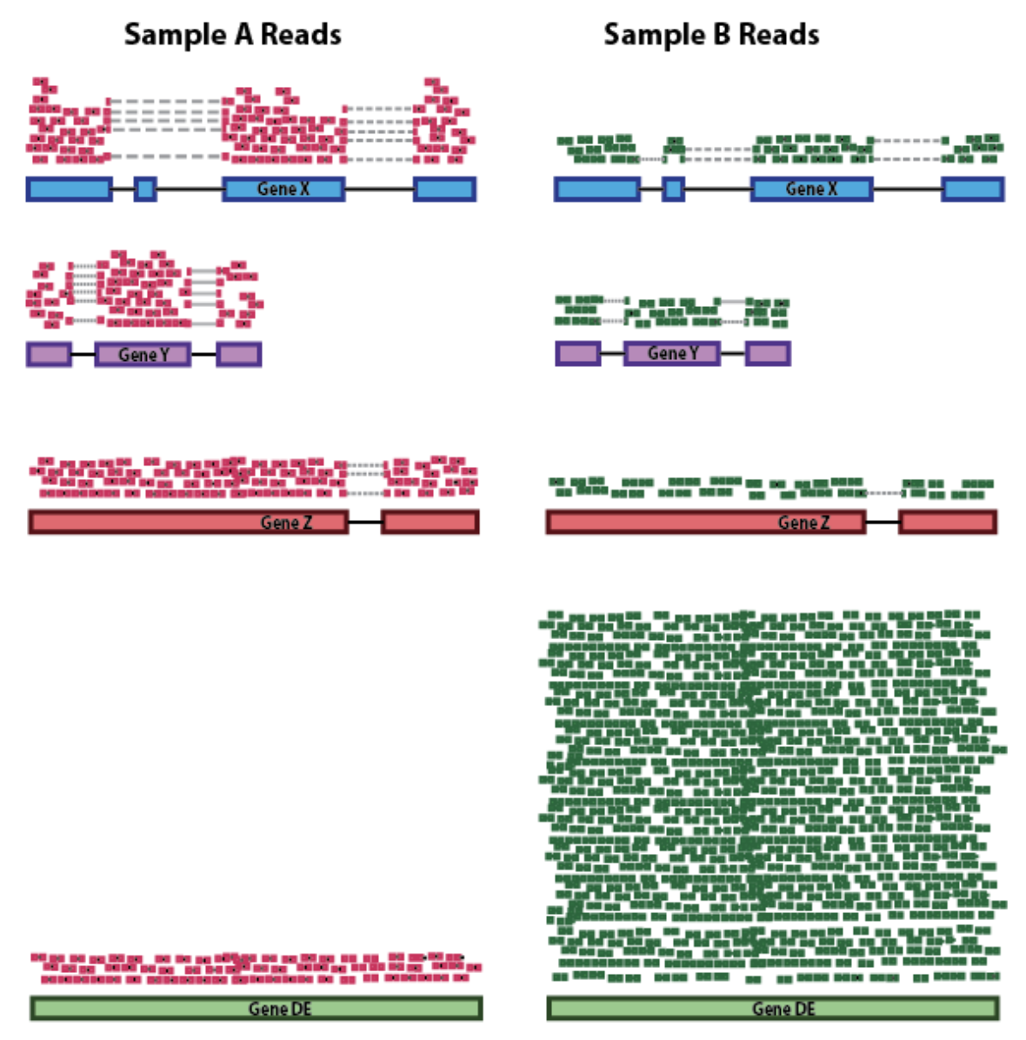
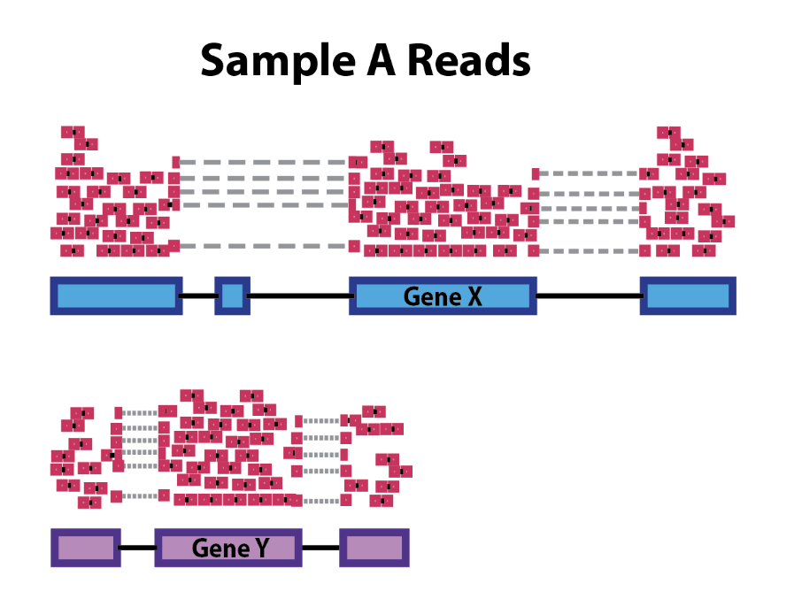
Normalization
Sequencing Depth
RNA composition
Gene length

Slide 40
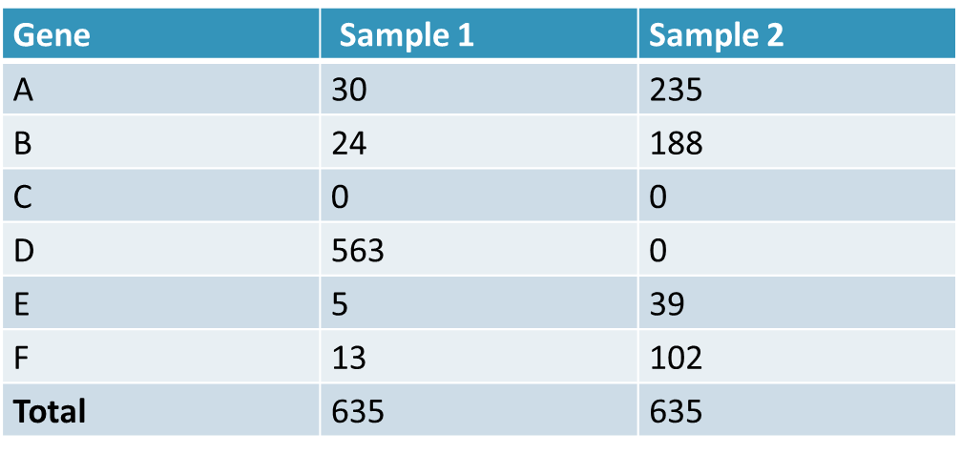
Normalization Limitations
Assume we have two identical samples
Knockout expression of Gene D in sample 2
Fixed Library size means remaining counts are redistributed over the remaining genes
Notes:
It is possible to see a difference in library composition in the same tissue type after the knock-out of a gene.
we have RNA-Seq counts from 2 samples (same library size: 635 reads), for a genome with 6 genes. The genes have the same expression in both samples, except one: only Sample 1 transcribes gene D, at a high level (563 reads). As the library size is the same for both samples, sample 2 has 563 extra reads to be distributed over genes A, B, C, E and F.
As a result, the read count for all genes except for genes C and D is really high in Sample 2. Nonetheless, the only differentially expressed gene is gene D.
TPM or RPKM do not deal with these differences in library composition during normalization, but more complex tools, like DESeq2, do.

Slide 41

Normalization with DESeq2
Notes:
normalize for sequencing depth and RNA composition, DESeq2 uses the median of ratios method. On the user-end there is only one step, but on the back-end there are multiple steps involved, as described below.
The goal is to calculate a scaling factor for each sample, which takes read depth and library composition into account.

Slide 42
Normalization with DESeq2
Gene | Sample 1 | Sample 2 | Sample 3
A | 0 | 10 | 4
B | 2 | 6 | 12
C | 33 | 55 | 200
Gene | log(Sample 1) | log(Sample 2) | log(Sample 3)
A | -Inf | 2.3 | 1.4
B | 0.7 | 1.8 | 2.5
C | 3.5 | 4.0 | 5.3
Notes:
normalize for sequencing depth and RNA composition, DESeq2 uses the median of ratios method. On the user-end there is only one step, but on the back-end there are multiple steps involved, as described below.
The goal is to calculate a scaling factor for each sample, which takes read depth and library composition into account.

Slide 43
Normalization with DESeq2
Average each gene
Filter out genes with infinite averages
Gene | Average of log values
A | -Inf
B | 1.7
C | 4.3
Gene | Average of log values
B | 1.7
C | 4.3
Notes:
The average of the log values (also known as the geometric mean) is used here because it is not easily impacted by outliers (e.g. gene C with its outlier for Sample 3).
Here we filter out genes with no read counts in at least 1 sample, e.g. genes only transcribed in one tissue like gene D in the previous example. This helps to focus the scaling factors on genes transcribed at similar levels, regardless of the condition.

Slide 44
Normalization with DESeq2
Subtract the average log value from the log counts:
Gene | log(Sample 1) | log(Sample 2) | log(Sample 3)
B | -1.0 | 0.1 | 0.8
C | -0.8 | -0.3 | 1.0
Calculate the median of the ratios for each sample:
Gene | log(Sample 1) | log(Sample 2) | log(Sample 3)
B | -1.0 | 0.1 | 0.8
C | -0.8 | -0.3 | 1.0
Median | -0.9 | -0.1 | 0.9
Notes:
Subtracting the average log value = this step compares the ratio of the counts in each sample to the average across all samples.
The median is used here to avoid extreme genes (most likely rare ones) from swaying the value too much in one direction. It helps to put more emphasis on moderately expressed genes.

Slide 45
Normalization with DESeq2
Compute the scaling factor by taking the exponential of the medians:
Gene | Sample 1 | Sample 2 | Sample 3
Median | -0.9 | -0.1 | 0.9
Scaling factors | 0.4 | 0.9 | 2.5
Compute the normalized counts: divide the original counts by the scaling factors:
Gene | Sample 1 | Sample 2 | Sample 3
A | 0 | 11.11 | 1.6
B | 5 | 6.67 | 4.8
C | 83 | 61.11 | 80
Notes:
DESeq2 also runs the Differential Gene Expression (DGE) analysis, which has two basic tasks:
Estimate the biological variance using the replicates for each condition
Estimate the significance of expression differences between any two conditions
This expression analysis is estimated from read counts and attempts are made to correct for variability in measurements using replicates, that are absolutely essential for accurate results.

Slide 46
Exercise: Creating DESeq2 object

Slide 47
Sample Clustering (PCA)
Principle component analysis compresses data into a smaller set of variables (dimension reduction)
From 20000 genes to 20 principal components
Useful during exploratory analysis
Are there confounding variables in the data?
Sex-specific differences?

Slide 48
Exercise: PCA Plots

Slide 49
Differential Expression

Slide 50
Differential Gene Expression
Goal: identify differentially expressed genes (DEGs)
Determine how treatment and covariates affect expression
Infer underlying biological mechanisms
Common methods:
DESeq2
edgeR
limma

Slide 51
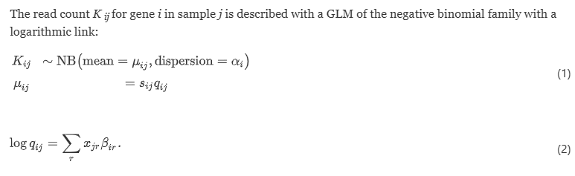
DESeq2
Models Gene Expression using Generalized Linear Models
Assumes counts are sampled from Negative-binomial distribution

Slide 52
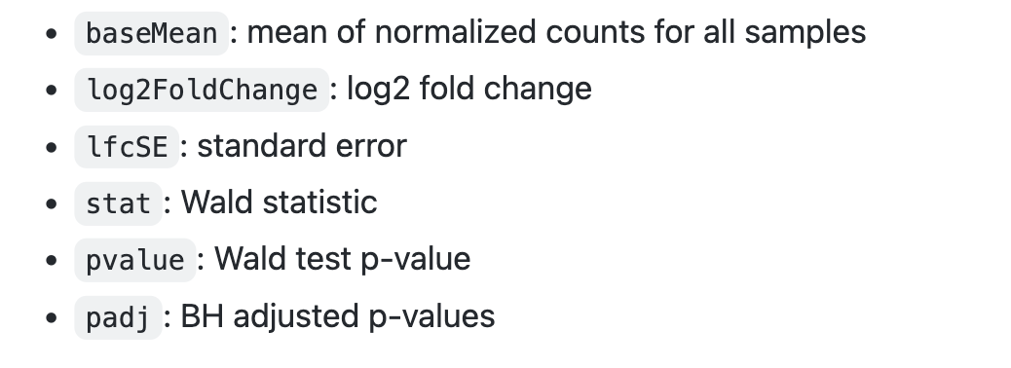

Slide 53
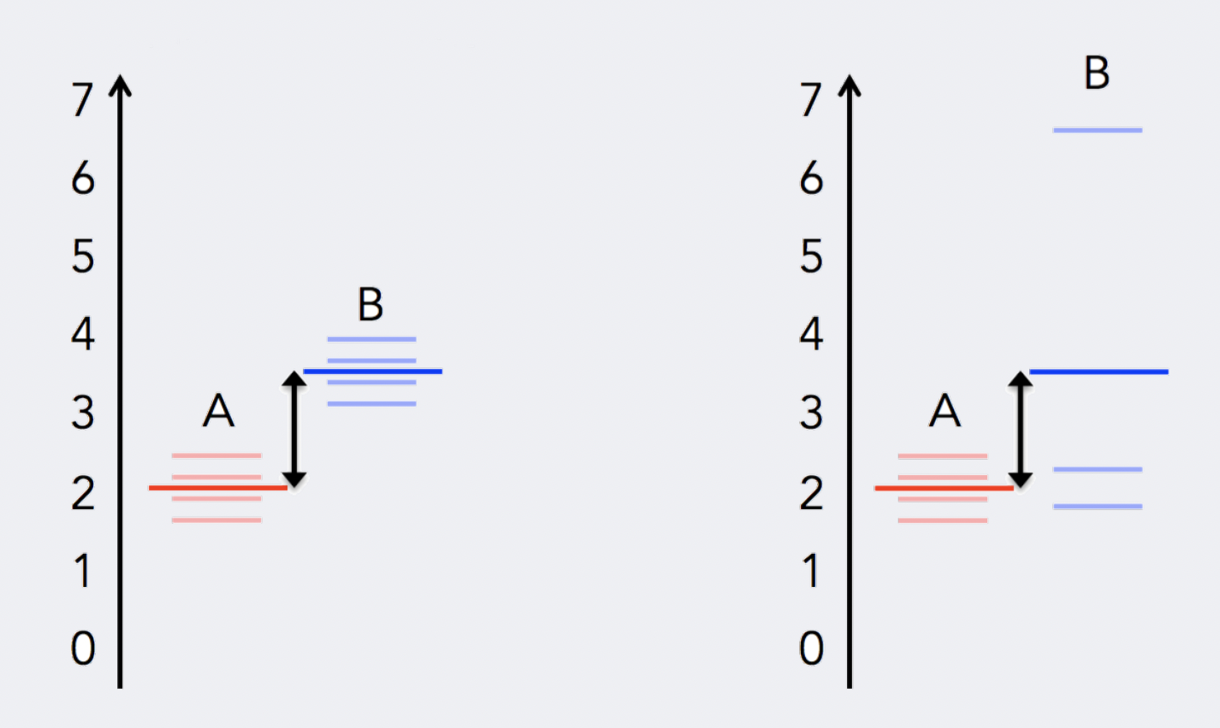
Uneven distribution of information
Replication introduces variance
Adapted from: https://hbctraining.github.io/DGE_workshop_salmon_online/schedule/links-to-lessons.html
Notes:
To determine differentially expressed genes, we evaluate the variation of expression between groups (of interest) and compare that to the variation within the groups (between replicates).

Slide 54
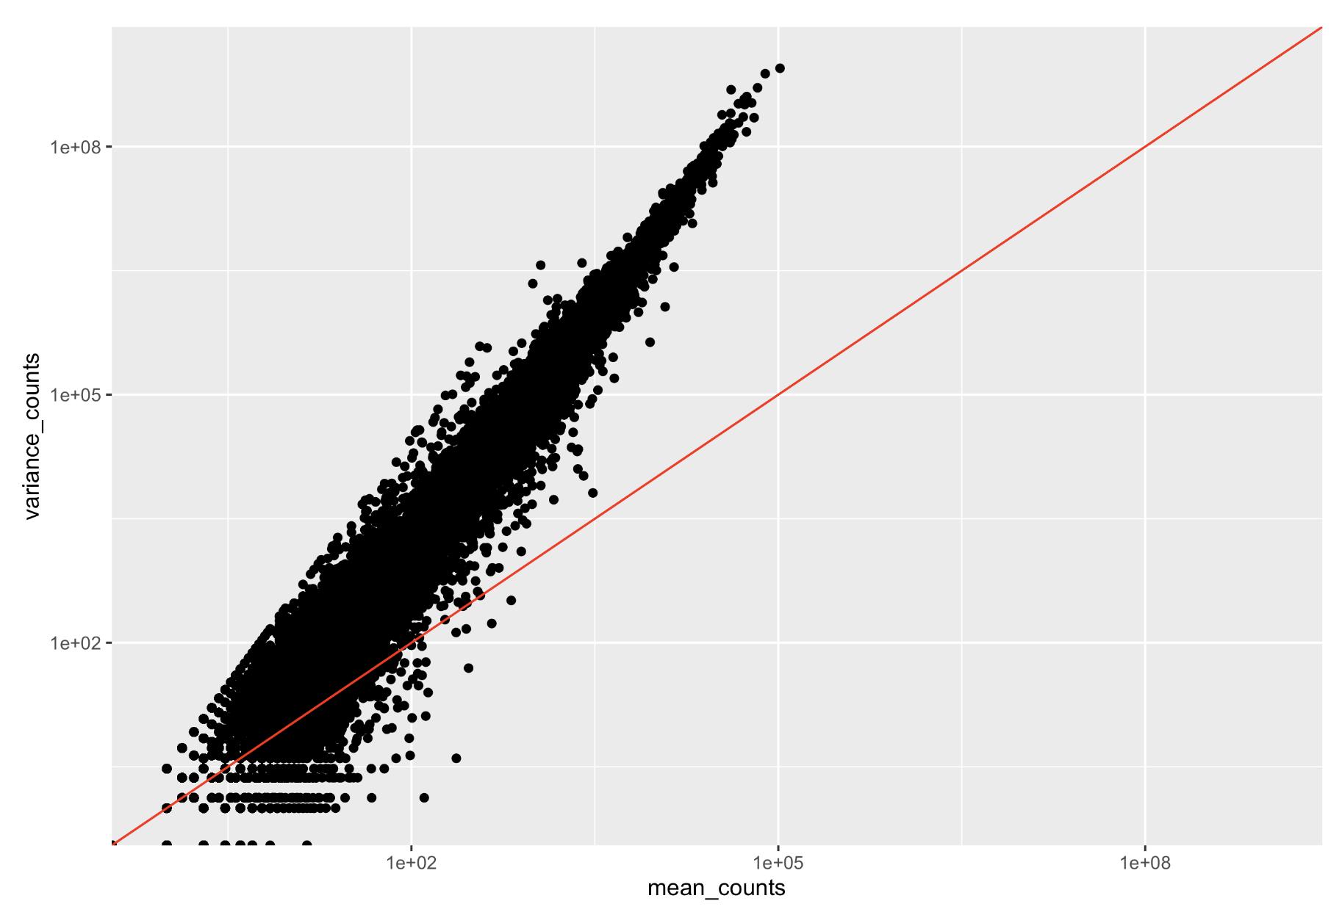
Uneven distribution of information
Adapted from: https://hbctraining.github.io/DGE_workshop_salmon_online/schedule/links-to-lessons.html
Notes:
For each individual gene, the mean is not equal to the variance.
Genes that are highly expressed will have a more consistent level of variations, but it will be higher than the mean.
Lowly expressed genes will exhibit variation that hovers around the mean (but with a higher amount of variability).
This complicated relationship means that we cannot just use the observed variance to account for within-group variation. Instead DESeq2 uses dispersion.

Slide 55
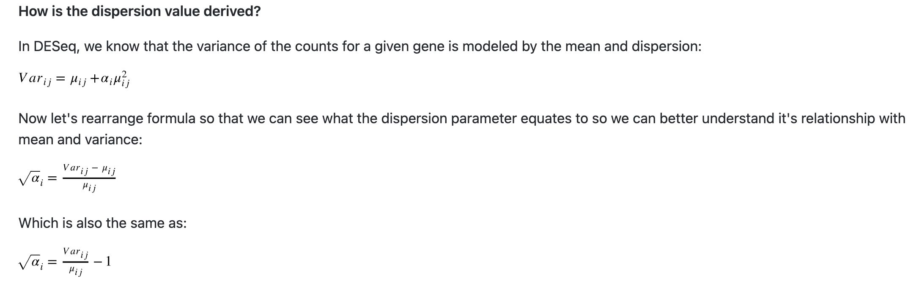
What is Dispersion?
A measure of spread or variability in the data
Rearranged:
Adapted from: https://hbctraining.github.io/DGE_workshop_salmon_online/schedule/links-to-lessons.html
Notes:
Variance, standard deviation, IQR, among other measures, can all be used to measure dispersion.
DESeq2 uses a specific measure of dispersion (α) related to the mean (μ) and variance of the data:
the square root of dispersion will be equal to the coefficient of variation (Var / μ).
dispersion is inversely related to the mean and directly related to variance.
So 0.01 dispersion means 10% variation around the mean expected across biological replicates.

Slide 56
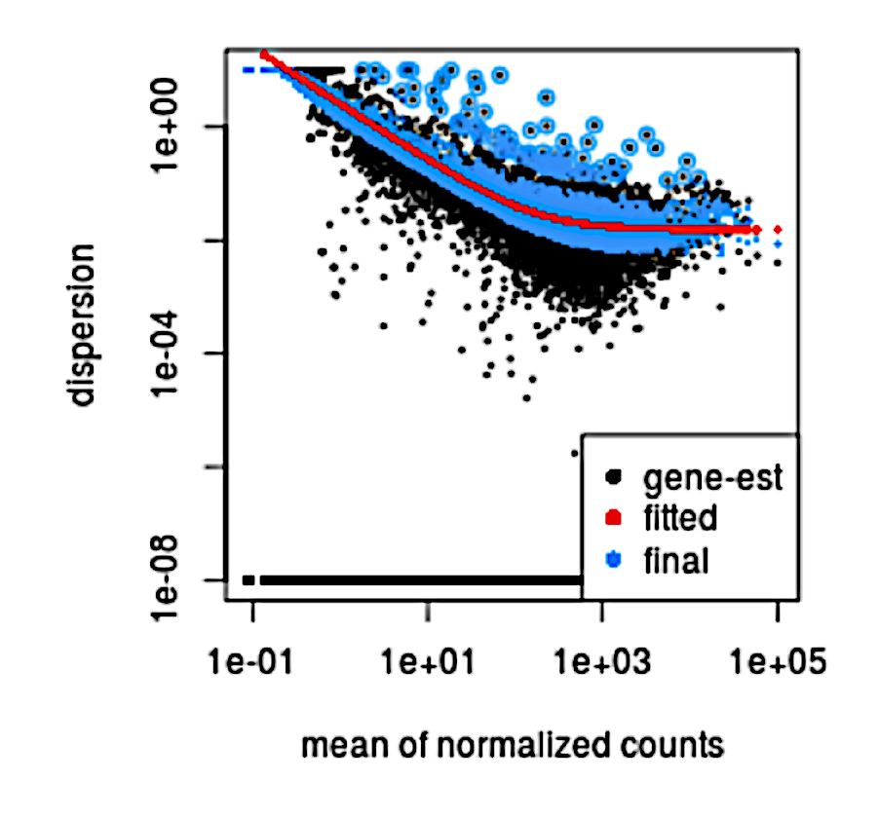
DESeq2 Dispersion
Adapted from: https://hbctraining.github.io/DGE_workshop_salmon_online/schedule/links-to-lessons.html
Notes:
we have a dispersion plot where each black dot is a gene
the dispersion is plotted against the mean expression for each gene. You can see the inverse relationship between mean and dispersion. The black dots are dispersion estimates given the data we have.
DESeq2 assumes that genes with similar expression levels should have similar dispersion.
Want to increase dispersion for genes with low estimates. Leave dispersion as is for genes with high estimates

Slide 57
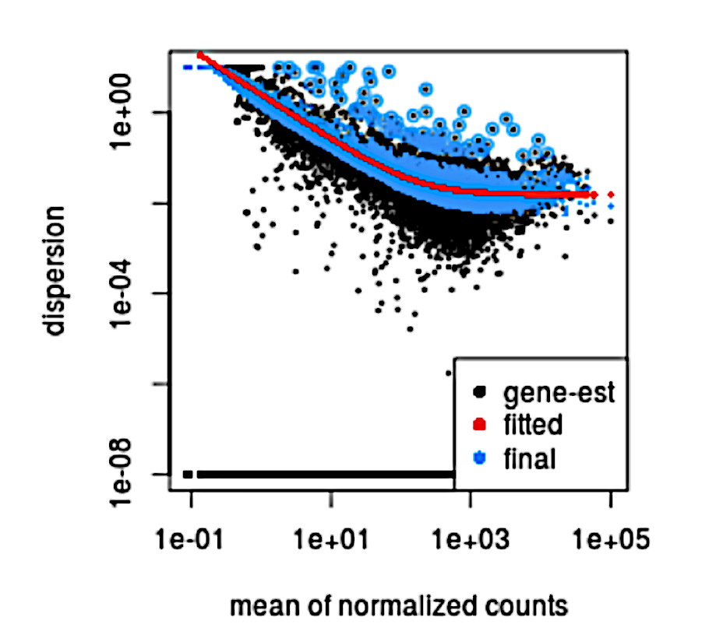
Fit curve to gene-wise estimates
Adapted from: https://hbctraining.github.io/DGE_workshop_salmon_online/schedule/links-to-lessons.html
Notes:
The next step in the workflow is to fit a curve to the gene-wise dispersion estimates. The idea behind fitting a curve to the data is that different genes will have different scales of biological variability, but, across all genes, there will be a distribution of reasonable estimates of dispersion.
This curve is displayed as a red line, which plots the estimate for the expected dispersion value for genes of a given expression strength.
Each black dot is a gene with an associated mean expression level and maximum likelihood estimation (MLE) of the dispersion

Slide 58
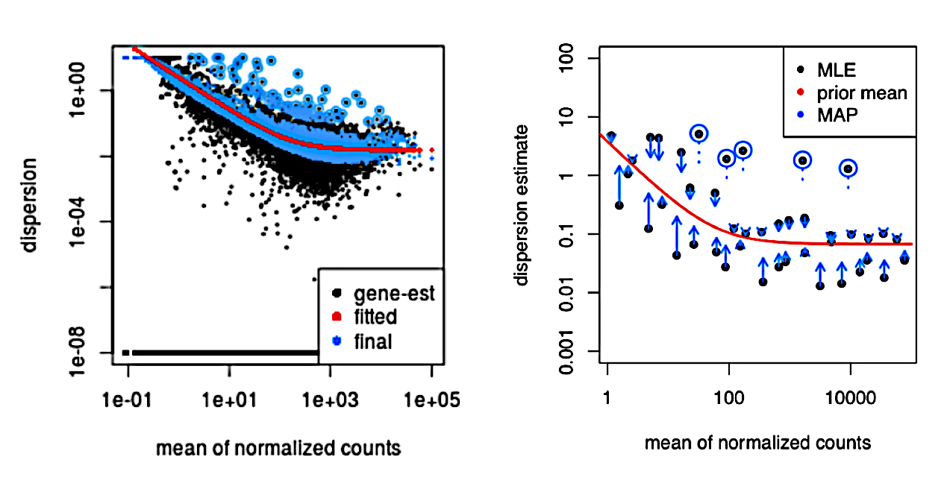
Dispersion shrinkage
Adapted from: https://hbctraining.github.io/DGE_workshop_salmon_online/schedule/links-to-lessons.html
Notes:
Once a curve is fitted, the next step is to shrink the gene-wise dispersion estimates toward the expected dispersion values.
The curve allows for more accurate identification of differentially expressed genes, and the strength of the shrinkage for each gene depends on :
how close gene dispersions are from the curve
sample size (more samples = less shrinkage)
This shrinkage method is particularly important to reduce false positives in the differential expression analysis. Genes with low dispersion estimates are shrunken towards the curve, and the more accurate, higher shrunken values are output for fitting of the model and differential expression testing. These shrunken estimates represent the within-group variation that is needed to determine whether the gene expression across groups is significantly different.
however, genes with extremely high dispersion values are not shrunk. This is due to the likelihood that the gene does not follow the modeling assumptions and has higher variability than others for biological or technical reasons .
- These genes are shown surrounded by blue circles below.
This is a good plot to examine to ensure your data is a good fit for the DESeq2 model. You expect your data to generally scatter around the curve, with the dispersion decreasing with increasing mean expression levels

Slide 59
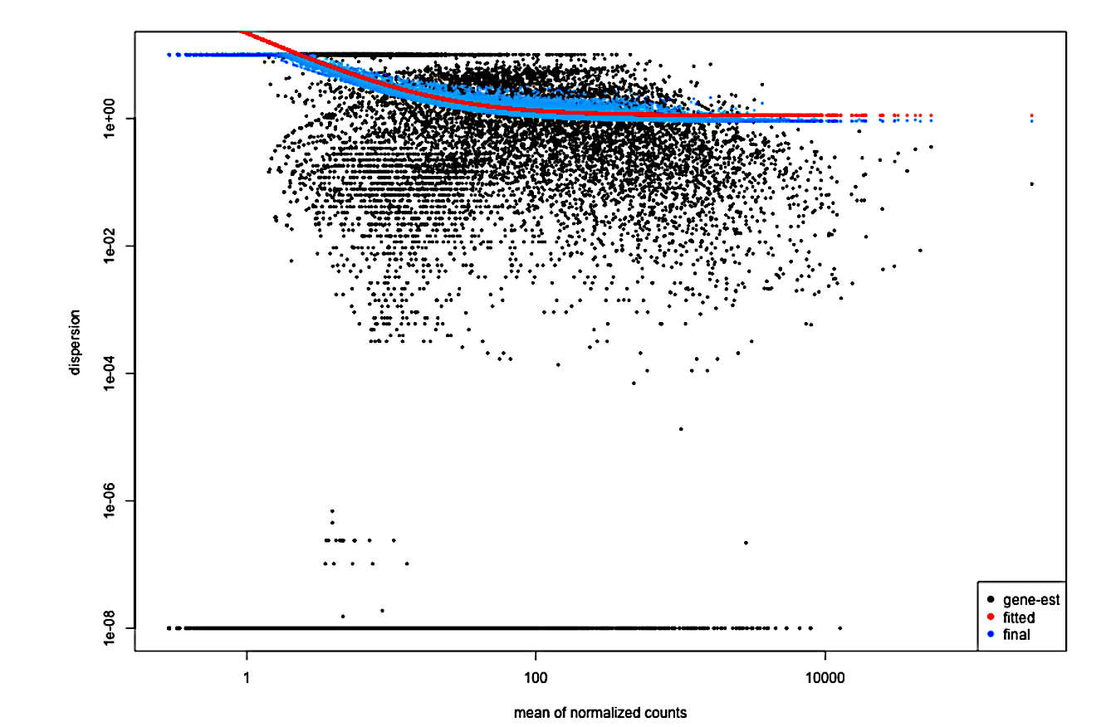
Concerning Plots
Adapted from: https://hbctraining.github.io/DGE_workshop_salmon_online/schedule/links-to-lessons.html
Notes:
If you see a cloud or different shapes, then you might want to explore your data more to see if you have contamination (mitochondrial, etc.) or outlier samples.
The plot shows a cloud of dispersion values, which do not generally follow the curve. This would be worrisome and suggests a bad fit of the data to the model.

Slide 60
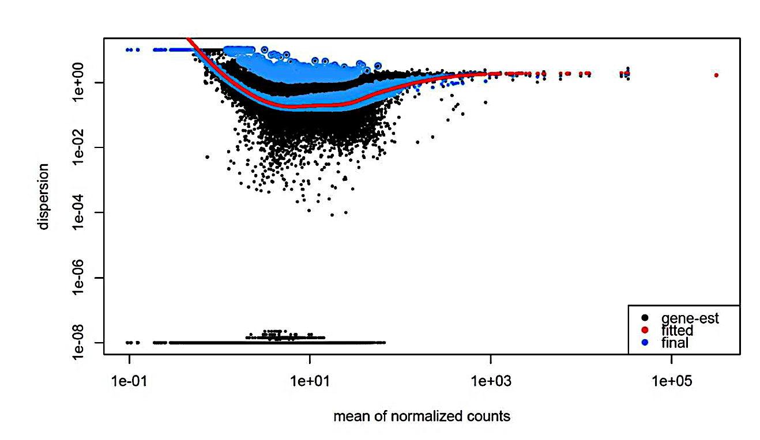
Concerning Plots
plotDispEsts(dds)
Adapted from: https://hbctraining.github.io/DGE_workshop_salmon_online/schedule/links-to-lessons.html
Notes:
The next plot shows the dispersion values initially decreasing, then increasing with larger expression values.
The larger mean expression values should not have larger dispersions based on our expectations - we expect decreasing dispersions with increasing mean.
This indicates that there is less variation for more highly expressed genes than expected. This also indicates that there could be an outlier sample or contamination present in our analysis.

Slide 61
Exercise: Differential Expression

Slide 62
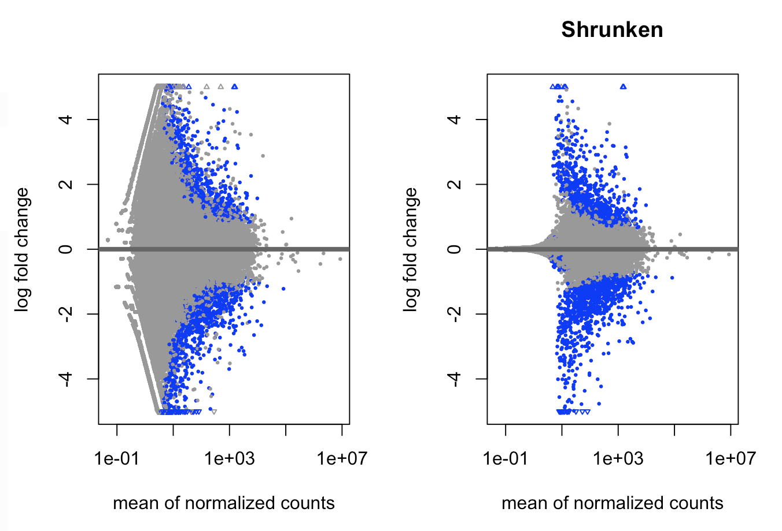
LFC Shrinkage
Reasons for shrinkage of LFC estimates of genes towards zero:
Low counts
High dispersion values
Love, M. I., Huber, W. & Anders, S. Genome Biology 15, doi:10.1186/s13059-014-0550-8 (2014).
Notes:
Both Maximum Likelihood Estimation (MLE) and Maximum A Posterior (MAP) are used to estimate parameters for a distribution
shrink LFC estimates toward zero when the information for a gene is low, which could include:
Low counts
High dispersion values
the distribution of LFC estimates for all genes is used (as a prior) to shrink the LFC estimates of genes with little information or high dispersion toward more likely (lower) LFC estimates.
it looks at the largest fold changes that are not due to low counts and uses these to inform a prior distribution. So the large fold changes from genes with lots of statistical information are not shrunk, while the imprecise fold changes are shrunk.
---
we first perform ordinary GLM fits to obtain maximum-likelihood estimates (MLEs) for the LFCs and then fit a zero-centered normal distribution to the observed distribution of MLEs over all genes. This distribution is used as a prior on LFCs in a second round of GLM fits, and the MAP estimates are kept as final estimates of LFC.
---
The resulting MAP (Maximum A Posterior) LFCs are biased toward zero in a manner that removes the problem of exaggerated LFCs for low counts. the strongest LFCs are no longer exhibited by genes with weakest expression. Rather, the estimates are more evenly spread around zero, and for very weakly expressed genes (with less than one read per sample on average), LFCs hardly deviate from zero, reflecting that accurate LFC estimates are not possible here.
---
for genes with little information for LFC estimation, a reduction of the strong variance is bought at the cost of accepting a bias toward zero, and this can result in an overall reduction in mean squared error, e.g., when comparing to LFC estimates from a new dataset. Genes with high information for LFC estimation will have, in our approach, LFCs with both low bias and low variance. Furthermore, as the degrees of freedom increase, and the experiment provides more information for LFC estimation, the shrunken estimates will converge to the unshrunken estimates.

Slide 63
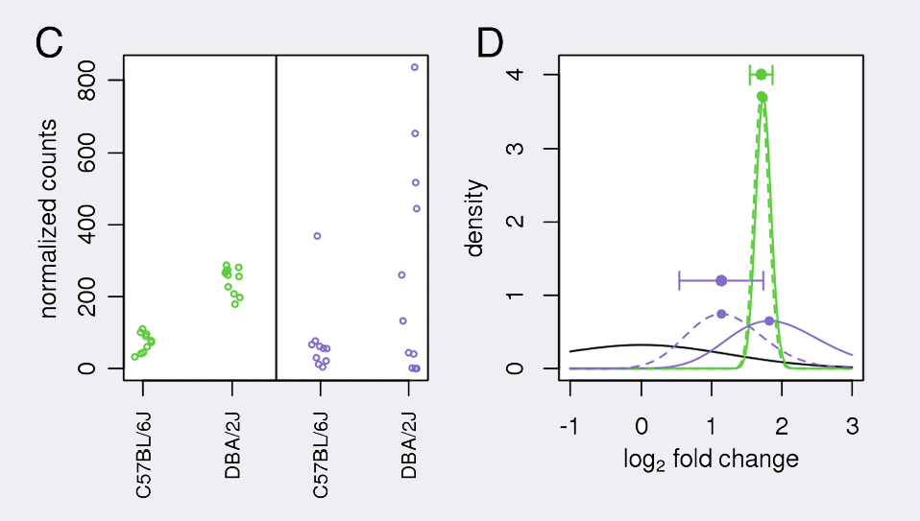
LFC Shrinkage Example
Love, M. I., Huber, W. & Anders, S. Genome Biology 15, doi:10.1186/s13059-014-0550-8 (2014).
Notes:
we have an example using two genes: green gene and purple gene.
the expression values are plotted for each sample in the two different mouse strains (C57BL/6J and DBA/2J).
Both genes have the same mean values for the two sample groups, but the green gene has little variation within group while the purple gene has high levels of variation.
For the green gene, the unshrunken LFC estimate (vertex of the green solid line) is very similar to the shrunken LFC estimate (vertex of the green dotted line).
LFC estimates for the purple gene are quite different due to the high dispersion. So even though two genes can have similar normalized count values, they can have differing degrees of LFC shrinkage.
Notice the LFC estimates are shrunken toward the prior (black solid line).
---
Density plots of the likelihoods (solid lines, scaled to integrate to 1) and the posteriors (dashed lines) for the green and purple genes and of the prior (solid black line): due to the higher dispersion of the purple gene, its likelihood is wider and less peaked (indicating less information), and the prior has more influence on its posterior than for the green gene.
---
Shrinking the log2 fold changes will not change the total number of genes that are identified as significantly differentially expressed. The shrinkage of fold change is to help with downstream assessment of results. For example, if you wanted to subset your significant genes based on fold change for further evaluation, you may want to use shrunken values. Additionally, for functional analysis tools such as GSEA which require fold change values as input you would want to provide shrunken values.
Depending on the version of DESeq2 you are using the default method for shrinkage estimation will differ. The defaults can be changed by adding the argument type in the lfcShrink() function as we have above. For most recent versions of DESeq2, type="normal" is the default and was the only method in earlier versions. It has been shown that in most situations there are alternative methods that have less bias than the 'normal` method, and therefore we chose to use apeglm.

Slide 64
Exercise: DGE with LFC shrinkage

Slide 65
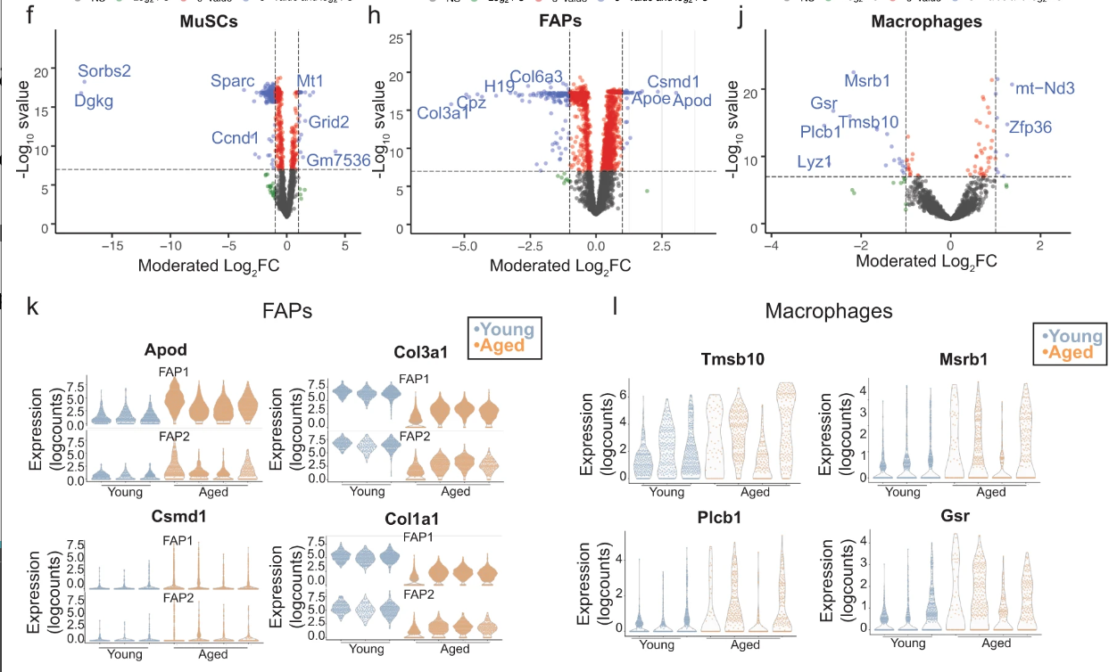
Visualizations
Visualization is an important step following DGE
Many options available
Mean-Abundance (MA) plot for diagnostics
Volcano Plot
Heatmap (useful for covariate-corrected models)
Box Plot
Violin Plot (usually single cell data)
Image Source: Lazure et al., Nature Comms 2023

Slide 66
Exercise: Visualizations

Slide 67
Functional Analysis

Slide 68
Functional Analyses
List of DEGs may be insufficient to explain disease mechanisms
Aim to determine what processes are represented by DEGs
Gene-set Enrichment Analysis (GSEA)
Gene ontology

Slide 69
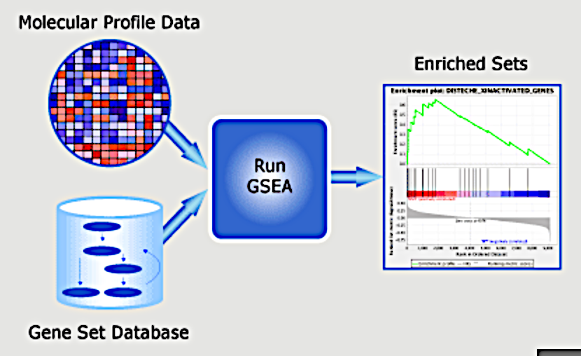
Gene set enrichment analysis (GSEA)
Subramanian, A. et al. PNAS 102, 15545-15550, doi:10.1073/pnas.0506580102 (2005).

Slide 70

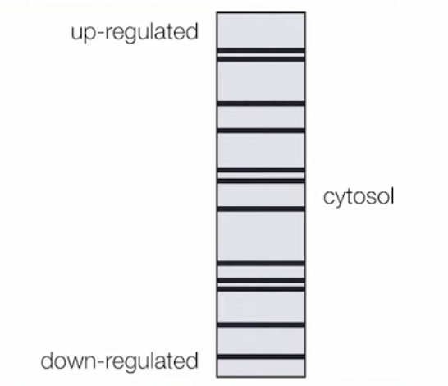
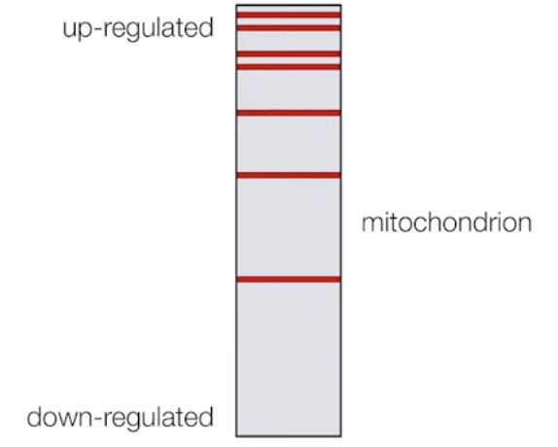
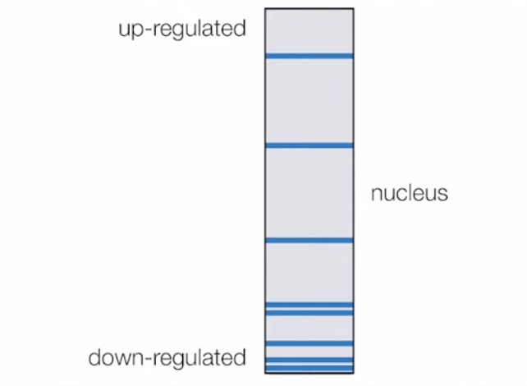
Ranked List
Subramanian, A. et al. PNAS 102, 15545-15550, doi:10.1073/pnas.0506580102 (2005). Eden, E., Navon, R.,
Notes:
The log2 fold changes for each gene in the ‘gene set S’ is shown as a line
- The large positive log2 fold changes are at the top of the gene set image, while the largest negative log2 fold changes are at the bottom of the gene set image
- Genes related to mitochondrion at top of list
- Nucleus genes bottom of list downregulated
- Cytosol no association
The goal is determine whether the members of a gene set are randomly distributed throughout the ranked gene list (L) or primarily found at the top or bottom
---
Kolmogorov–Smirnov test: to test for which term shows a non-random distribution across sorted list

Slide 71
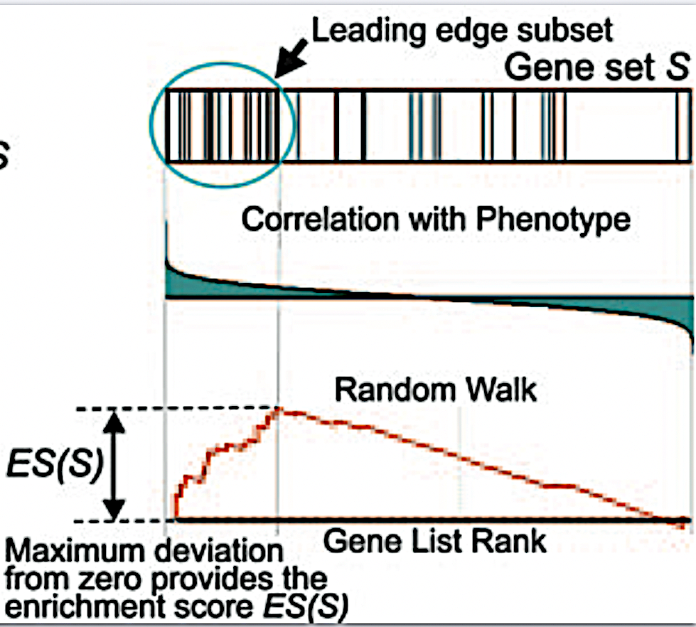
Enrichment Score Calculation
Notes:
An enrichment score for a particular gene set is calculated by walking down the list of log2 fold changes and increasing the running-sum statistic every time a gene in the gene set is encountered and decreasing it when genes are not part of the gene set.
- The size of the increase/decrease is determined by magnitude of the log2 fold change.
- The final enrichment score is where the running-sum statistic is the largest deviation from zero.
The p-value of the ES is calculated using a permutation test
- Randomize labels and calculate a distribution of scores. See where true ES lies for p-value
After all gene sets are tested, the enrichment scores are normalized for the size of the gene set, then the p-values are corrected for multiple testing.
---
Permutation test: permute the gene labels of the gene list L and recompute the ES of the gene set for the permutated data, which generate a null distribution for the ES. The pvalue of the observed ES is then calculated relative to this null distribution
---
The GSEA output will yield the core genes in the gene sets that most highly contribute to the enrichment score.
The genes output are generally the genes at or before the running sum reaches its maximum value (eg. the most influential genes driving the differences between conditions for that gene set).
Step 2: Estimation of significance:
The significance of the enrichment score is determined using permutation testing, which performs rearrangements of the data points to determine the likelihood of generating an enrichment score as large as the enrichment score calculated from the observed data.
Essentially, for this step, the first permutation would reorder the log2 fold changes and randomly assign them to different genes, reorder the gene ranks based on these new log2 fold changes, and recalculate the enrichment score. The second permutation would reorder the log2 fold changes again and recalculate the enrichment score again, and this would continue for the total number of permutations run. Therefore, the number of permutations run will increase the confidence in the significance estimates.
Step 3: Adjust for multiple test correction
After all gene sets are tested, the enrichment scores are normalized for the size of the gene set, then the p-values are corrected for multiple testing.

Slide 72
Exercise: fgsea Package

Slide 73
Exercise: MSigDB

Slide 74
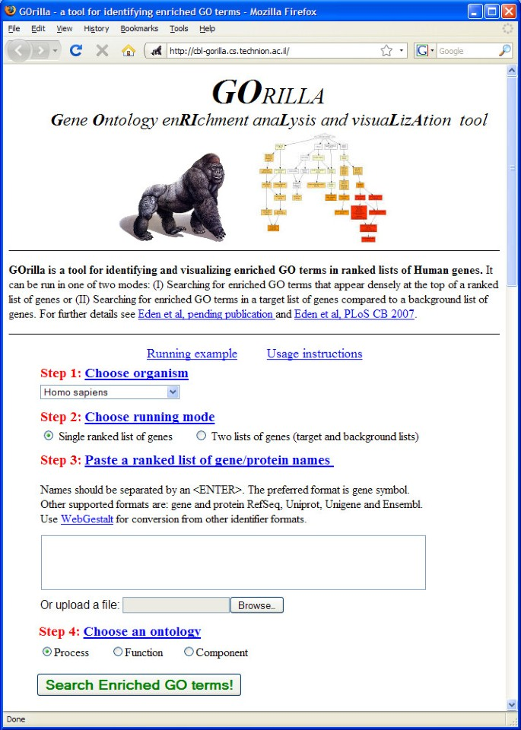
Gene Ontology
Gene Sets don’t consider hierarchical structure
Gene Ontology presents gene sets along a hierarchy
Hypergeometric distribution
Steinfeld, I. et al. GOrilla: a tool for discovery and visualization of enriched GO terms in ranked gene lists. BMC Bioinformatics 10, 48 (2009). https://doi.org/10.1186/1471-2105-10-48

Slide 75
Single Cell Data

Slide 76
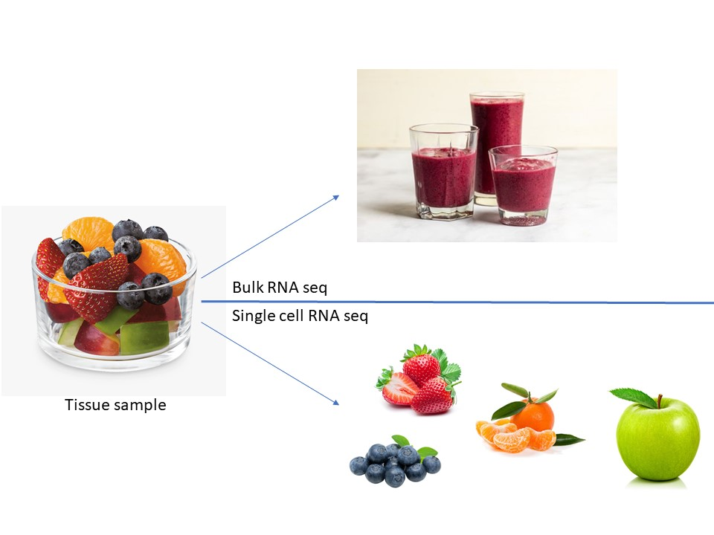
What is Single-Cell Sequencing
Bulk Sequencing collects the average profile of a tissue
No information specific to a cell type
Can be biased by cell type proportions of sample
Single-Cell sequencing collects cell-specific profiles of tissue
Have information for individual cells
Can get information for small cell populations

Slide 77
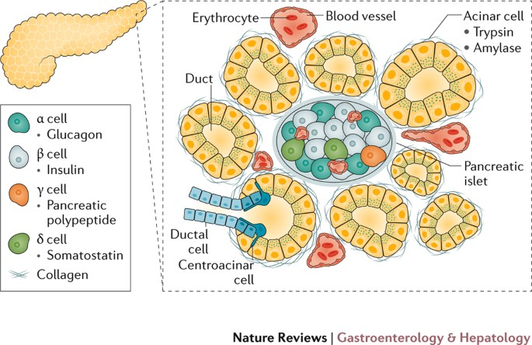
Why use it?
Could collect cell type-specific bulk data by using FACS
Assumptions
Cell types of interest are known
Their markers are known
Conditions do not affect markers
Advantages?
Can use the entire profile to identify cell types
Can identify new cell types or states
Ellis et al. 2017, Nature Reviews

Slide 78
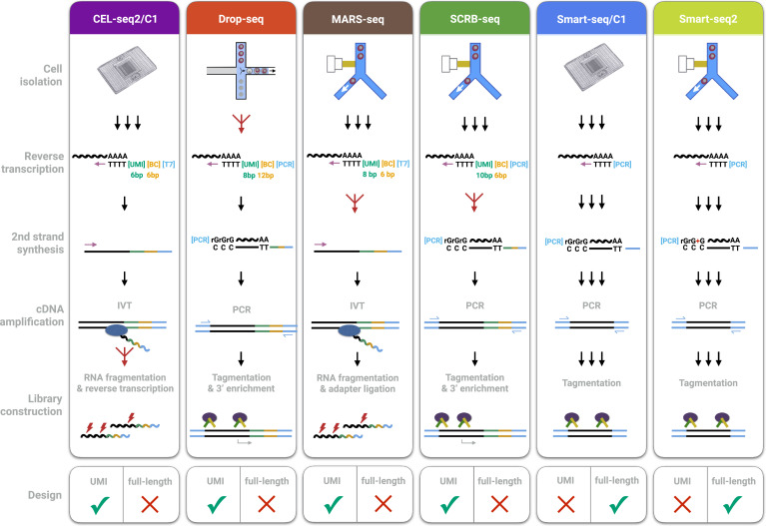
Methods/Technology
Cell Isolation
Plate-based
FACS-based
Droplet-based
Reverse Transcription
2nd Strand Synthesis
cDNA Amplification
Library Construction
Ziegenhain et al., 2017, Molecular Cell

Slide 79
10X vs. SMART-seq2
10X
Droplet-based – High throughput for cheap
UMI (Unique Molecular Identifier) – Can Multiplex cells and samples
High dropout rate
SMART-seq2
Plate-based – lower throughput and more expensive
Full read design – More reliable gene detection and can assess splicing
Data is less noisy
Notes:
UMI – Unique Molecular Identifier (10X)
Added in library prep to help identify unique mRNA molecules before PCR amplification
Helps filter out PCR artifacts
Multiplexing is possible (can pool the libraries and sequence them simultaneously)
Full read Design (SMART-seq2)
Good read coverage across the whole transcript (alternative splicing)
Multiplexing is not possible

Slide 80
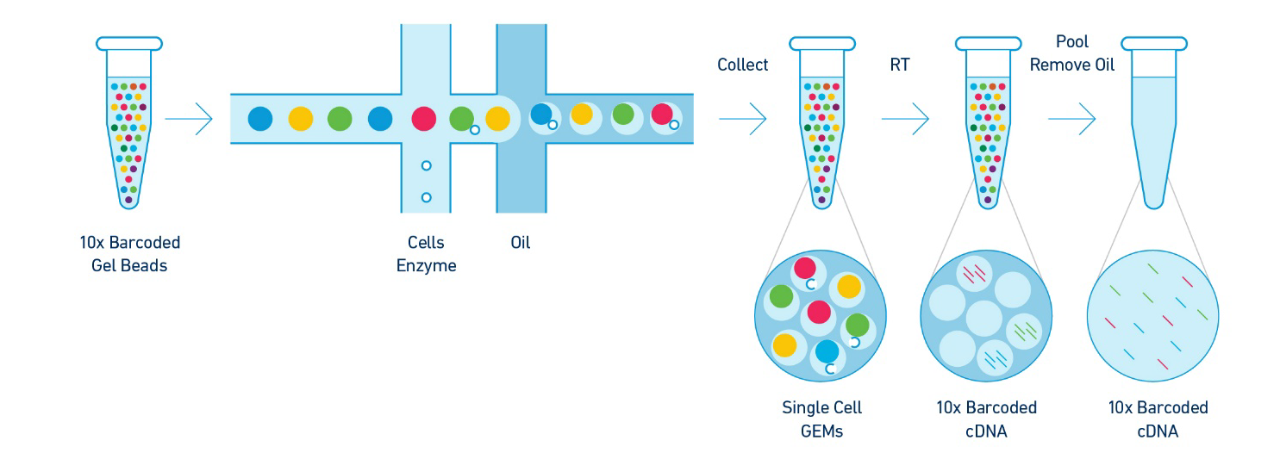
10X Chromium

Slide 81
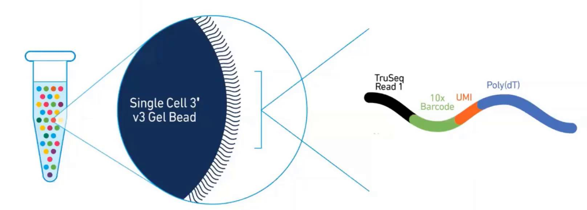
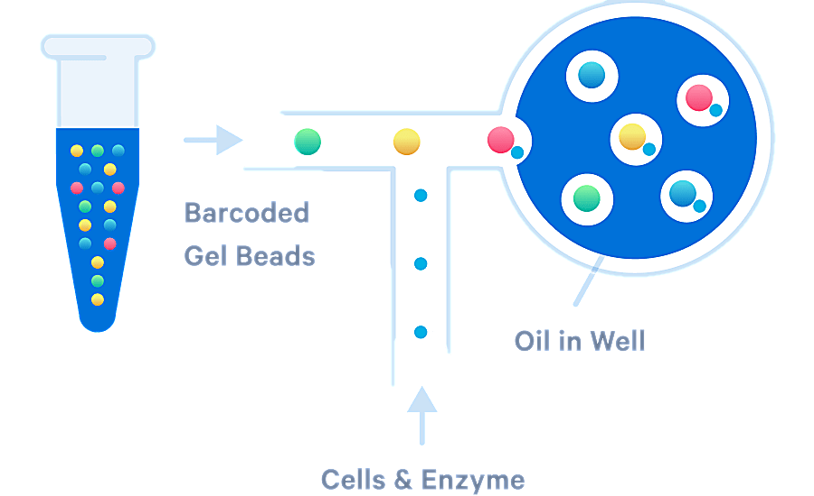
GEMs – Gel Bead Emulsion Droplets
Gel Bead
UMI (Unique Molecular Identifier)
Cell barcode
Individual Cells
ONE cell per droplet
Enzymes
Reverse Transcriptase

Slide 82
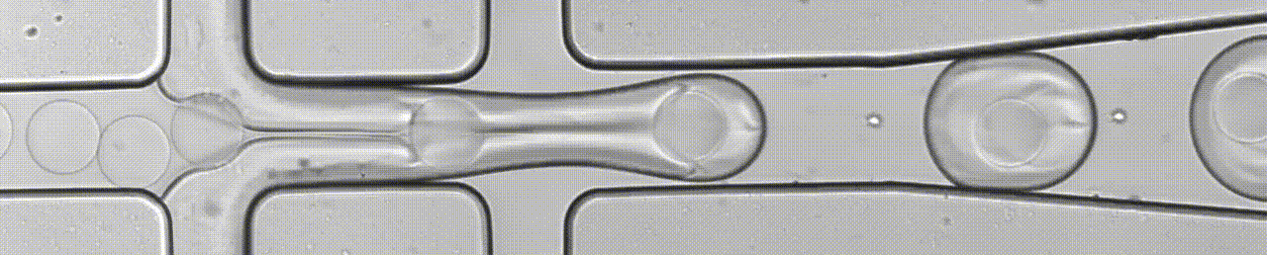
Aerts lab (Katholieke Universiteit Leuven)

Slide 83
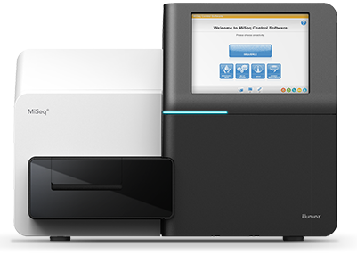
Sequencing
Sequenced by standard short-read sequencing (e.g. Illumina).
Paired-end
Read 1 – Barcode and UMI
Read 2 – mRNA transcript
Output:
Base Call Files (BCL)

Slide 84
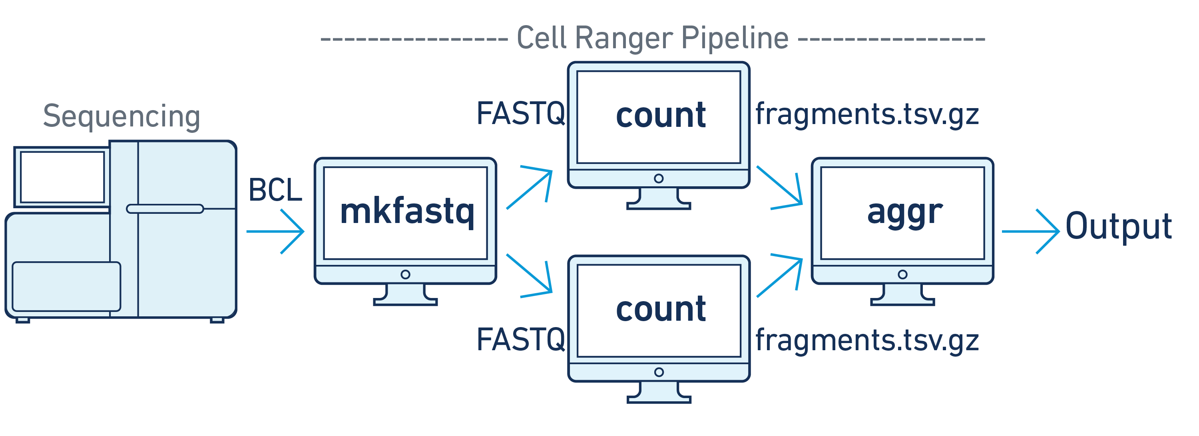
Processing
Cellranger
UNIX-based software from 10X Genomics
Used to process single cell data
Installation
2.1.0 is pre-installed on Compute Canada
Newer versions available as .tar files on 10X website
Notes:
Recommended 128GB RAM, 16 cores

Slide 85
Quality Control
Cellranger calculates basic quality metrics for you
Provides an html file as output which you can review
Read depth
Empty droplets etc.
Also provides CLOUPE file with basic data exploration done
Subsequent quality control can be done in your analysis software
Proportion of mt-genes
Sparsity etc.

Slide 86
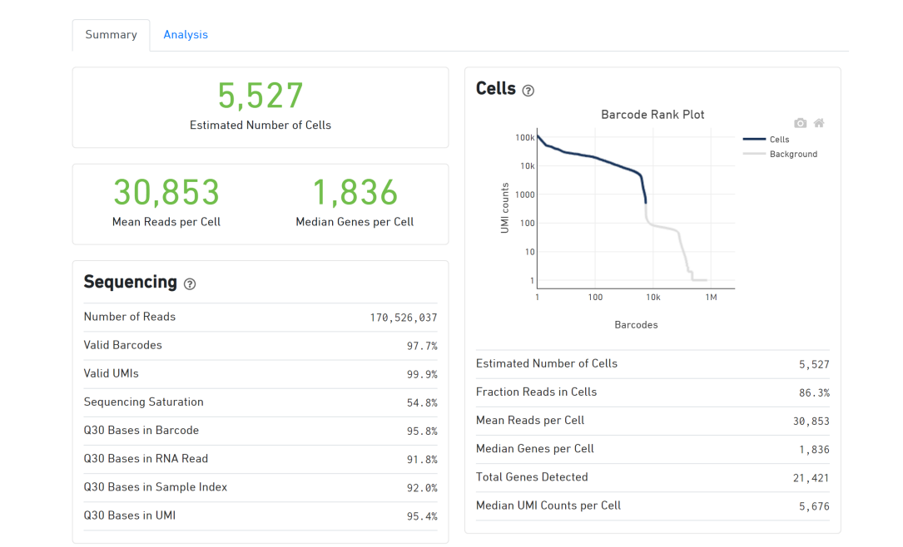
Web Summary HTML

Slide 87
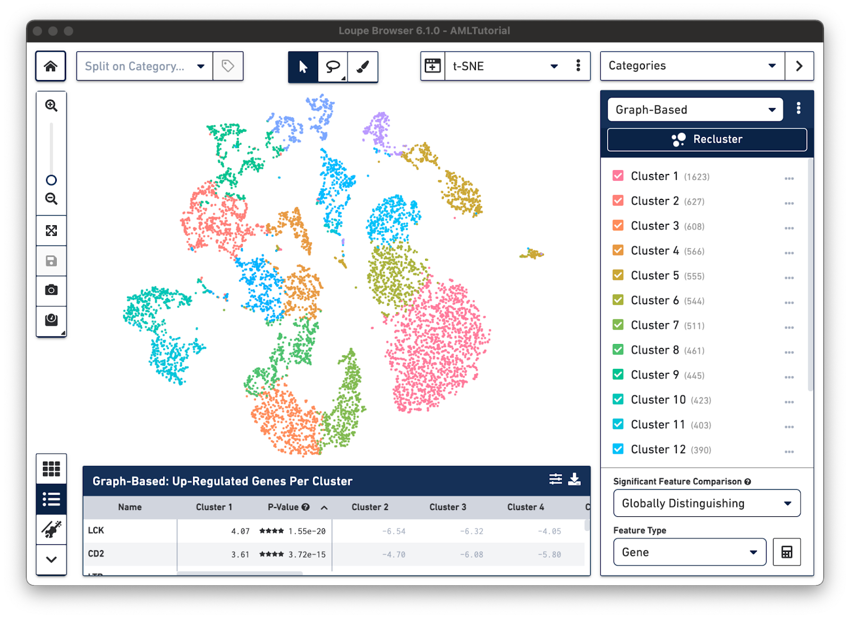
LOUPE Browser

Slide 88
SingleCellExperiment

Slide 89
SingleCellExperiment
An R-based package that acts as an analysis framework for single cell data
Also consider Seurat

Slide 90
Exercise: Loading 10X Data

Slide 91
Quality Control & Filtering
Mitochondrial contamination
# of Genes
# of cells expressing gene X
Doublet detection

Slide 92
Exercise: SCE Quality Control

Slide 93
UMAP/tSNE
Non-linear dimension reduction techniques
More reliable than PCA for single cell data
Easier to discern cell type-specific clusters
Better stratification of cell states

Slide 94
Cell Type Labelling
Marker Identification
Violin plots
Expression visualization with UMAP/tSNE

Slide 95
Exercise: UMAP and Cell Type Labelling

Slide 96
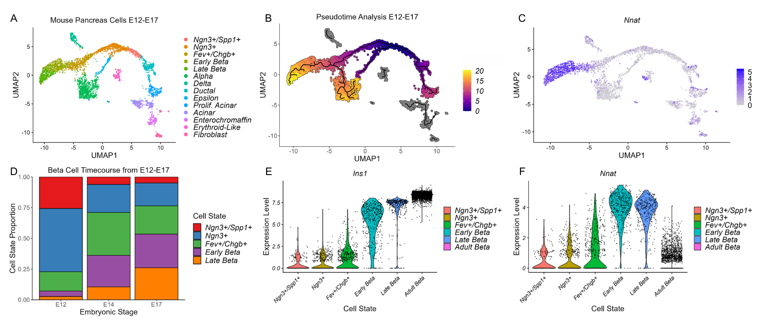
Single Cell Analyses

Slide 97
Closing Remarks

Slide 98
To summarize
RNA-seq is a powerful tool for transcript identification AND quantification
Experimental design decisions greatly depend on your research question
Bulk & Single cell RNA-seq provide distinct pros and cons depending on your research question
Now you are ready to:
Consider what experimental design you need for RNA-seq studies
Run a standard DGE & GSEA analysis
Use pipeline tools through the Galaxy framework
Run basic analyses for single cell data

Slide 99
Acknowledgements
Material
Reinnier Padilla (HGEN)
Exercises
Galaxy Tutorial Page
DESeq2 Vignettes
OSCA eBook
Data
10X Genomics
Stephen Turner

Slide 100



Thank you for attending!
1
2
3
Scan the QR code to confirm you attended today’s workshop.
Fill out the feedback survey in the next 72h.
Get recognition for this workshop on your
co-curricular record.

